Slide 1

RATING PREDICTION
Guided By:
Shubham Yadav
Presented By:
Amritesh Kumar
<number>

Slide 2
INTRODUCTION
We have a client who has a website where people write different reviews for technical products. Now they are adding a new feature to their website i.e. The reviewer will have to add stars(rating) as well with the review.
The rating is out 5 stars and it only has 5 options available 1 star, 2 stars, 3 stars, 4 stars, 5 stars. Now they want to predict ratings for the reviews which were written in the past and they don’t have a rating.
Wehave to build an application which can predict the rating by seeing the review.
2

Slide 3
EXPERIMENTAL SET UP
Hardware requirements:-
1. Processor — core i5 and above
2. RAM — 8 GB or above
3. SSD— 250 GB or above
Software requirements:-
1. ANACONDA
2

Slide 4
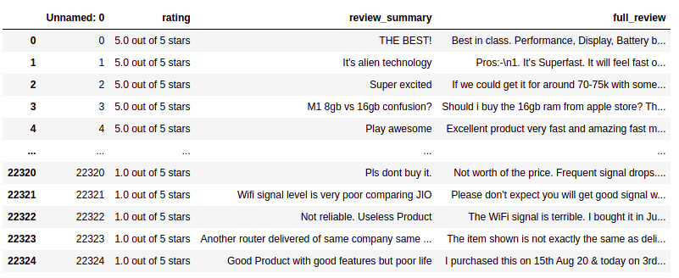
DATA PREPRATION
With the help of Pandas Library We will upload our data to Jupyter Notebook.
Once our data is uploaded with the help of predefined method (i.e. read_csv) we can read data for further processing.
We have two type of variables in the data:-
Dependent Variable
Independent Variable
2

Slide 5
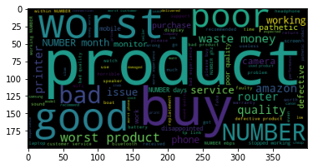
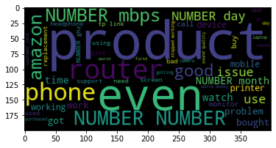
ONE STAR RATING
Review Title Review Description
<number>

Slide 6
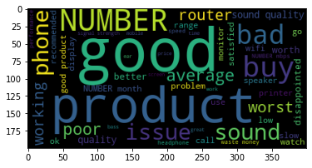
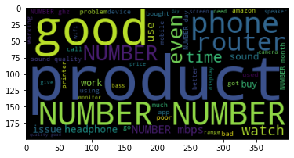
TWO STAR RATING
Review Title Review Description

Slide 7
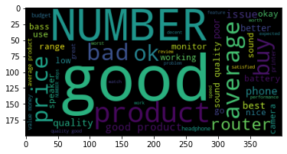
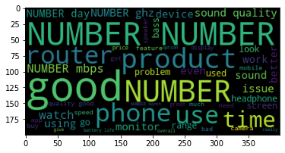
THREE STAR RATING
Review Title Review Description
<number>

Slide 8
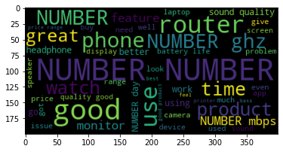
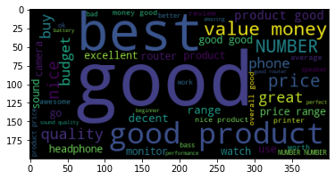
FOUR STAR RATING
Review Title Review Description
<number>

Slide 9
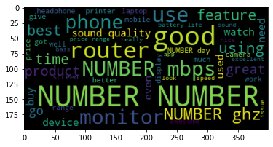
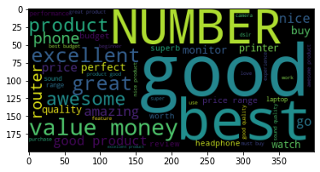
FIVE STAR RATING
Review Title Review Description
<number>

Slide 10
DATA PREPROCESSING
The Complete data is divided in the ration of 80:20 for train and test respectively.
There is no null value present in the data set and almost all the columns type is objective so we don’t need to check for outliers.
Once our data is ready, we’ll do further processing.
I have not dropped any column since the model accuracy is good.
<number>

Slide 11

EVALUTION PROCESS
Evaluation Matrices:
Accuracy - it determines how often a model predicts default and non default correctly.
Precision-it calculates whenever our models predicts it is default how often it is correct.
Recall- Recall regulate the actual default that the model is actually predict.
Precision Recall Curve - PRC will display the tradeoff between Precision and Recall threshold.
Cross Validations:
K Fold cross validations , K = 5
<number>

Slide 12
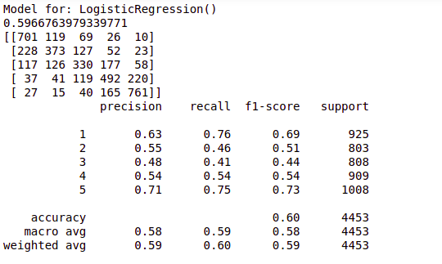
Logistic Regression
<number>

Slide 13
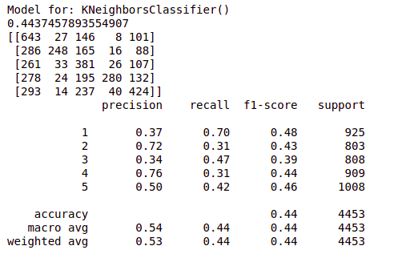
K-neighbors Classifier
<number>

Slide 14
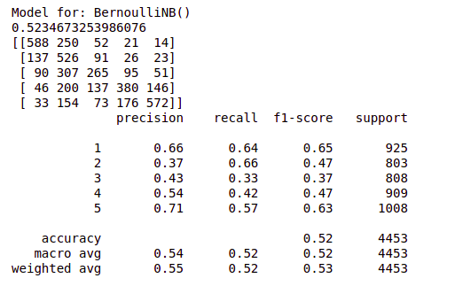
Bernoulli NB
<number>

Slide 15
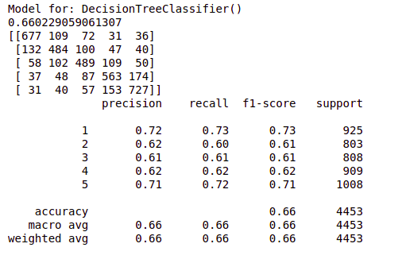
Decision Tree Classifier
<number>

Slide 16
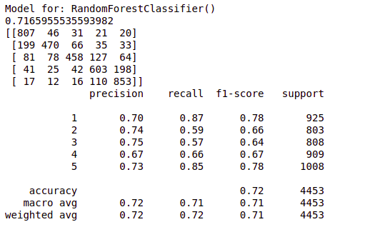
Random Forest Classifier
<number>

Slide 17
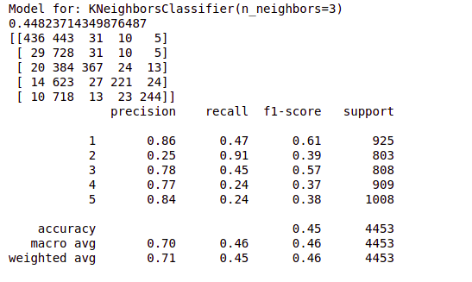
K neighbors Classifier (n_neighbors=3)
<number>

Slide 18
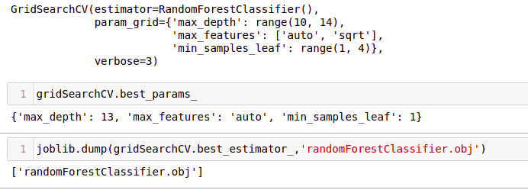
RESULT
From the details on the above solutions it is clearly understandable that we are getting best result with the help of SVC, so we save this model with the help of joblib Library.
<number>

Slide 19
CONCLUSION
As we know data is increasing in every second in our day today life. So more the data better the model.
If we make this data set for sentiment analysis, we choose ratings 3 or more as our threshold for being helpful reviews or good or positive reviews and below 3 we choose reviews is not helpful or bad reviews or negative reviews.
For example: two people give their reviews on a product as ‘a nice product. But their ratings are ‘4’ and ‘5’ respectively. This is where the model fails to predict whether to choose rating ‘4’ or’5’.
Due to increase in data in our daily basics, this model can be used to predict ratings of reviews.
It might be a good tool for online shopping sites and manufacturer companies who may predict their customers ratings so that they can make their investment according to the demand of customers, which might help them to save time and earn more profits.
<number>

Slide 20
THANK YOU
<number>

